Slide 1
Database System II- IS313P chapter 22: Concurrency Control Techniques
Aziza Asem and Amira Rezk

Slide 2
Quiz
Which of the following schedules is (conflict) serializable?
a. r1(X); r3(X); w1(X); r2(X); w3(X);
b. r1(X); r3(X); w3(X); w1(X); r2(X);
c. r3(X); r2(X); w3(X); r1(X); w1(X);
d. r3(X); r2(X); r1(X); w3(X); w1(X);

Slide 3
Agenda
Introduction
Pessimistic Concurrency Control
Guaranteeing Serializability by Two-Phase Locking
Dealing with Deadlock and Starvation
Concurrency Control Based on Timestamp Ordering

Slide 4
Introduction
Why Concurrency Control Is Needed
The Lost Update Problem
The Temporary Update (or Dirty Read) Problem
The Incorrect Summary Problem
Purpose of Concurrency Control
To enforce Isolation (through mutual exclusion) among conflicting transactions.
To preserve database consistency through consistency preserving execution of transactions.
To resolve read-write and write-write conflicts.

Slide 5
Introduction
Conflict occurs if two operations satisfy with
They belong to different transactions
They access the same item X
At least one of the operation is
write_item(X)
Example
r1(X) and w2(X): conflict
r2(X) and w1(X): conflict
r1(X) and r2(X): Not conflict
w2(X) and w1(Y): Not conflict
r1(X) and w1(X): Not conflict

Slide 6
Introduction
Concurrency Control Techniques
Pessimistic Concurrency Control (LOCK)
Assumes that conflicts will happen
Detect conflicts as soon as they occur and
Resolve them using blocking.
Optimistic Concurrency Control
Assumes that conflicts between transactions are rare.
Does not require locking
Transaction executed without restrictions
Check for conflicts just before commit

Slide 7
Pessimistic Concurrency Control Locking
A lock is a variable associated with each data item in the database.
A lock describes the status of the data item with respect to possible operations that can be applied to that item. It is used for synchronising the access by concurrent transactions to the database items.
A transaction locks an object before using it
When an object is locked by another transaction, the requesting transaction must wait

Slide 8
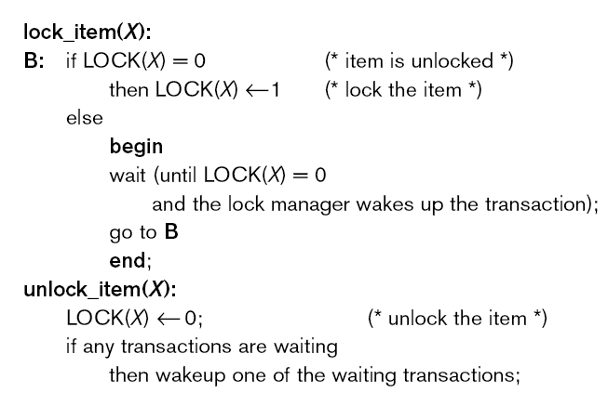
Types of Locks
A binary lock can have two states or values: locked and unlocked (1- 0 )

Slide 9
Types of Locks … A binary lock
lock table, a hash file on the item name.
Items not in the lock table are considered to be unlocked.
In its simplest form, each lock can be a record with three fields: <Data_item_name, LOCK, Locking_transaction> plus a queue for transactions that are waiting to access the item.
The DBMS has a lock manager subsystem to keep track of and control access to locks.
T is said to hold the lock on item X.
At most one transaction can hold the lock on a particular item.
Thus no two transactions can access the same item concurrently.

Slide 10
Types of Locks … A binary lock
If the simple binary locking scheme is used, every transaction must obey the following rules:
A transaction T must issue the operation lock_item(X) before any read_item(X) or write_item(X) operations are performed in T.
A transaction T must issue the operation unlock_item(X) after all read_item(X) and write_item(X) operations are completed in T.
A transaction T will not issue a lock_item(X) operation if it already holds the lock on item X.
A transaction T will not issue an unlock_item(X) operation unless it already holds the lock on item X.

Slide 11
Types of Locks … Shared/Exclusive (or Read/Write) Locks
There are three locking operations: read_lock(X), write_lock(X), and unlock(X).
A lock associated with an item X, LOCK(X), now has three possible states: read-locked, write-locked, or unlocked.
A read-locked item is also called share-locked because other transactions are allowed to read the item,
A write-locked item is called exclusive-locked because a single transaction exclusively holds the lock on the item.

Slide 12
Types of Locks … Shared/Exclusive (or Read/Write) Locks
the system must enforce the following rules:
A transaction T must issue the operation read_lock(X) or write_lock(X) before any read_item(X) operation is performed in T.
A transaction T must issue the operation write_lock(X) before any write_item(X) operation is performed in T.
A transaction T must issue the operation unlock(X) after all read_item(X) and write_item(X) operations are completed in T.
A transaction T will not issue a read_lock(X) operation if it already holds a read (shared) lock or a write (exclusive) lock on item X.
A transaction T will not issue a write_lock(X) operation if it already holds a read (shared) lock or write (exclusive) lock on item X.
A transaction T will not issue an unlock(X) operation unless it already holds a read (shared) lock or a write (exclusive) lock on item X.

Slide 13
Types of Locks …Conversion of Locks.
lock conversion; that is, a transaction that already holds a lock on item X is allowed under certain conditions to convert the lock from one locked state to another.
it is possible for a transaction T to issue a read_lock(X) and then later to upgrade the lock by issuing a write_lock(X) operation.
If T is the only transaction holding a read lock on X at the time it issues the write_lock(X) operation, the lock can be upgraded; otherwise,
the transaction must wait.
It is also possible for a transaction T to issue a write_lock(X) and then later to downgrade the lock by issuing a read_lock(X) operation.
When upgrading and downgrading of locks is used, the lock table must include transaction identifiers in the record structure for each lock (in the locking_transaction(s) field) to store the information on which transactions hold locks on the item.

Slide 14
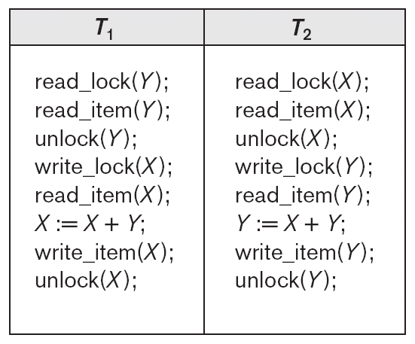
Initial values: X=20, Y=30
Result serial schedule T1 followed by T2: X=50, Y=80
Result of serial schedule T2 followed by T1: X=70, Y=50

Slide 15
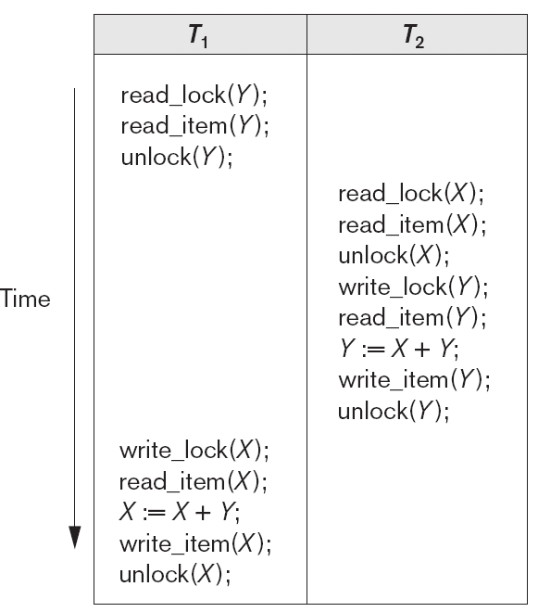
Result of schedule S:
X=50, Y=50
(nonserializable)

Slide 16
Guaranteeing Serializability by Two-Phase Locking
Two Phases:
(a) Locking (Growing / Expanding)
(b) Unlocking (Shrinking).
Locking (Growing) Phase:
A transaction applies locks (read or write) on desired data items one at a time.
Unlocking (Shrinking) Phase:
A transaction unlocks its locked data items one at a time.
Requirement:
For a transaction these two phases must be mutually exclusively, that is, during locking phase unlocking phase must not start and during unlocking phase locking phase must not begin.

Slide 17
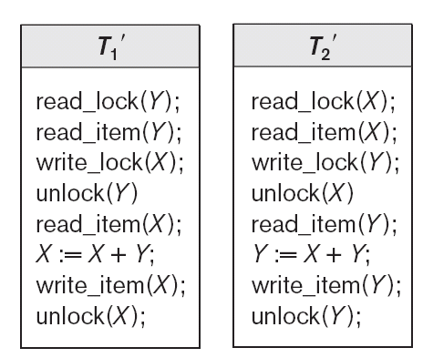
Transactions T1 and T2, which are the same as T1 and T2, but follow the two-phase locking protocol.

Slide 18
Two-Phase Locking
Two-phase policy generates two locking algorithms
(a) Basic
(b) Conservative
Basic:
Transaction locks data items incrementally. This may cause deadlock which is dealt with.
Strict:
A more stricter version of Basic algorithm where unlocking is performed after a transaction terminates (commits or aborts and rolled-back). This is the most commonly used two-phase locking algorithm.
Conservative:
Prevents deadlock by locking all desired data items before transaction begins execution.

Slide 19
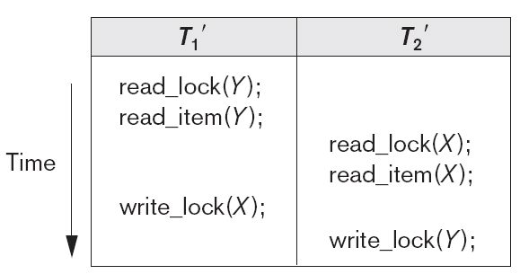
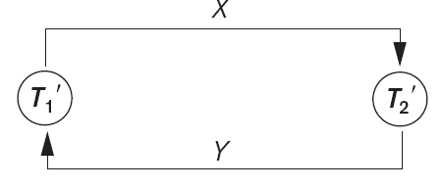
Dealing with Deadlock and Starvation
Deadlock occurs when each transaction T in a set of two or more transactions is waiting for some item that is locked by some other transaction T in the set.

Slide 20
Dealing with Deadlock and Starvation
Deadlock prevention
A transaction locks all data items it refers to before it begins execution.
This way of locking prevents deadlock since a transaction never waits for a data item.
The conservative two-phase locking uses this approach.

Slide 21
Dealing with Deadlock and Starvation
Deadlock detection and resolution
In this approach, deadlocks are allowed to happen. The scheduler maintains a wait-for-graph for detecting cycle. If a cycle exists, then one transaction involved in the cycle is selected (victim) and rolled-back.
A wait-for-graph is created using the lock table. As soon as a transaction is blocked, it is added to the graph. When a chain like: Ti waits for Tj waits for Tk waits for Ti or Tj occurs, then this creates a cycle.
AA
B
C
D
A

Slide 22
Dealing with Deadlock and Starvation
Deadlock avoidance
There are many variations of two-phase locking algorithm.
Some avoid deadlock by not letting the cycle to complete.
That is as soon as the algorithm discovers that blocking a transaction is likely to create a cycle, it rolls back the transaction.
Wait-Die and Wound-Wait algorithms use timestamps to avoid deadlocks by rolling-back victim.

Slide 23
Dealing with Deadlock and Starvation
Wait-die
If TS(Ti) < TS(Tj), then (Ti older than Tj)
Ti is allowed to wait
Otherwise (Ti younger than Tj)
Abort Ti (Ti dies) and restart it later with the same timestamp
Wound-wait
If TS(Ti) < TS(Tj), then (Ti older than Tj)
Abort Tj (Ti wounds Tj) and restart it later with the same timestamp
Otherwise (Ti younger than Tj)
Ti is allowed to wait

Slide 24
Dealing with Deadlock and Starvation
Starvation
Starvation occurs when a particular transaction consistently waits or restarted and never gets a chance to proceed further.
In a deadlock resolution it is possible that the same transaction may consistently be selected as victim and rolled-back.
This limitation is inherent in all priority based scheduling mechanisms.
One solution for starvation is to have a fair waiting scheme, such as using a first-come-first-served queue
In Wound-Wait scheme a younger transaction may always be wounded (aborted) by a long running older transaction which may create starvation.

Slide 25
Concurrency Control Based on Timestamp Ordering
Timestamp is a unique identifier created by the DBMS to identify a transaction.
timestamp values are assigned in the order in which the transactions are submitted to the system, so a timestamp can be thought of as the transaction start time.
The timestamp of transaction T is TS(T).
Time Stamps use:
1. Counter that is incremented each time its value is assigned to a transaction (1,2,3…)
2. Use system clock and ensure that no two timestamp values are generated during the same tick of the clock.

Slide 26
The Timestamp Ordering Algorithm
1. read_TS(X). The read timestamp of item X is the largest timestamp among all the timestamps of transactions that have successfully read item X—that is,
read_TS(X) = TS(T), where T is the youngest transaction that has read X successfully.
2. write_TS(X). The write timestamp of item X is the largest of all the timestamps of transactions that have successfully written item X—that is,
write_TS(X) = TS(T), where T is the youngest transaction that has written X successfully.

Slide 27
Basic Timestamp Ordering (TO).
1. Transaction T issues a write_item(X) operation:
If read_TS(X) > TS(T) or if write_TS(X) > TS(T), then an younger transaction has already read the data item so abort and roll-back T and reject the operation.
If the condition in part (a) does not exist, then execute write_item(X) of T and set write_TS(X) to TS(T).
2. Transaction T issues a read_item(X) operation:
If write_TS(X) > TS(T), then an younger transaction has already written to the data item so abort and roll-back T and reject the operation.
If write_TS(X) ≤ TS(T), then execute read_item(X) of T and set read_TS(X) to the larger of TS(T) and the current read_TS(X).

Slide 28
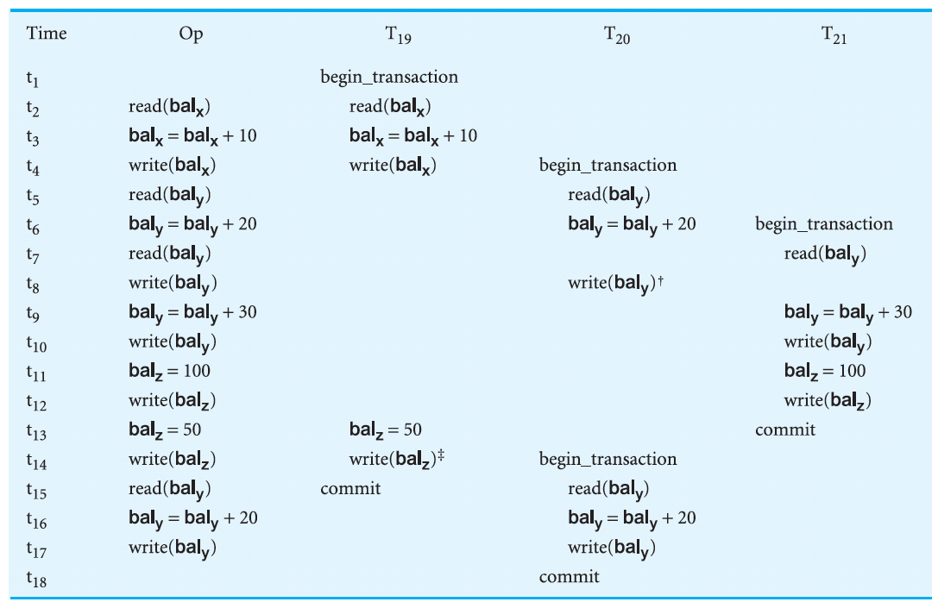

Slide 29
Strict Timestamp Ordering
1. Transaction T issues a write_item(X) operation:
If TS(T) > read_TS(X), then delay T until the transaction T’ that wrote or read X has terminated (committed or aborted).
2. Transaction T issues a read_item(X) operation:
If TS(T) > write_TS(X), then delay T until the transaction T’ that wrote or read X has terminated (committed or aborted).

Slide 30
Questions?

